Slide 1
Data Visualization
http://www.cs.ubc.ca/~tmm/talks.html#vad15d3

Slide 2
Defining visualization (vis)
Computer-based visualization systems provide visual representations of datasets designed to help people carry out tasks more effectively.
Why?...

Slide 3


Why have a human in the loop?
Computer-based visualization systems provide visual representations of datasets designed to help people carry out tasks more effectively.
Visualization is suitable when there is a need to augment human capabilities rather than replace people with computational decision-making methods.
don’t need vis when fully automatic solution exists and is trusted
many analysis problems ill-specified
don’t know exactly what questions to ask in advance
possibilities
long-term use for end users (e.g. exploratory analysis of scientific data)
presentation of known results
stepping stone to better understanding of requirements before developing models
help developers of automatic solution refine/debug, determine parameters
help end users of automatic solutions verify, build trust
3

Slide 4

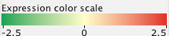
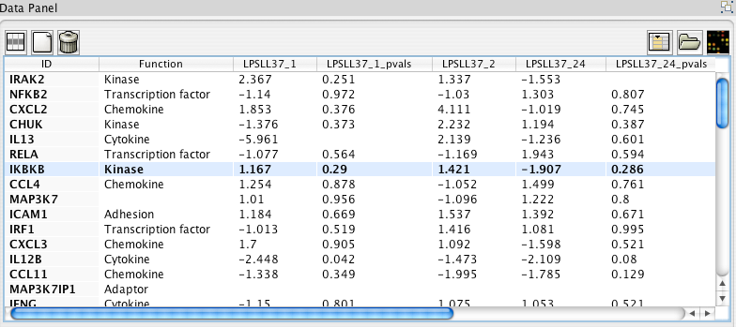
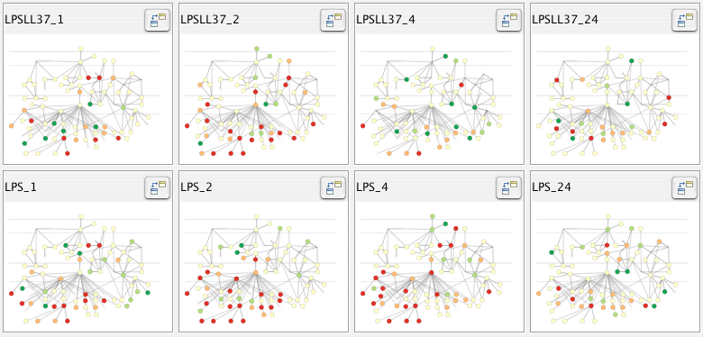
Why use an external representation?
Computer-based visualization systems provide visual representations of datasets designed to help people carry out tasks more effectively.
external representation: replace cognition with perception
[Cerebral: Visualizing Multiple Experimental Conditions on a Graph with Biological Context. Barsky, Munzner, Gardy, and Kincaid. IEEE TVCG (Proc. InfoVis) 14(6):1253-1260, 2008.]
4

Slide 5

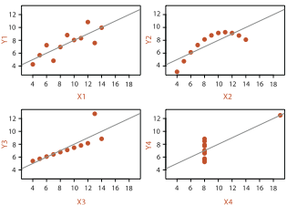
Why represent all the data?
Computer-based visualization systems provide visual representations of datasets designed to help people carry out tasks more effectively.
summaries lose information, details matter
confirm expected and find unexpected patterns
assess validity of statistical model
Anscombe’s Quartet
Identical statistics
x mean | 9
x variance | 10
y mean | 8
y variance | 4
x/y correlation | 1
5

Slide 6
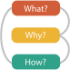
Analysis framework: Four levels, three questions
domain
domain situation
who are the target users?
abstraction
translate from specifics of domain to vocabulary of vis
what is shown? data abstraction
often don’t just draw what you’re given: transform to new form
why is the user looking at it? task abstraction
idiom
how is it shown?
visual encoding idiom: how to draw
interaction idiom: how to manipulate
algorithm
efficient computation
abstraction
idiom
algorithm
[A Nested Model of Visualization Design and Validation.
Munzner. IEEE TVCG 15(6):921-928, 2009 (Proc. InfoVis 2009). ]
domain
abstraction
idiom
algorithm
[A Multi-Level Typology of Abstract Visualization Tasks
Brehmer and Munzner. IEEE TVCG 19(12):2376-2385, 2013 (Proc. InfoVis 2013). ]

Slide 7
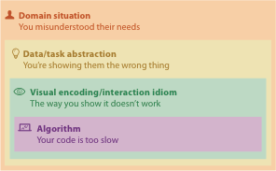
Why is validation difficult?
different ways to get it wrong at each level
7

Slide 8
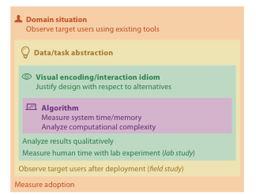


Why is validation difficult?
solution: use methods from different fields at each level
problem-driven work
anthropology/ ethnography
design
computer science
technique-driven work
cognitive psychology
anthropology/ ethnography
[A Nested Model of Visualization Design and Validation. Munzner. IEEE TVCG 15(6):921-928, 2009 (Proc. InfoVis 2009). ]

Slide 9
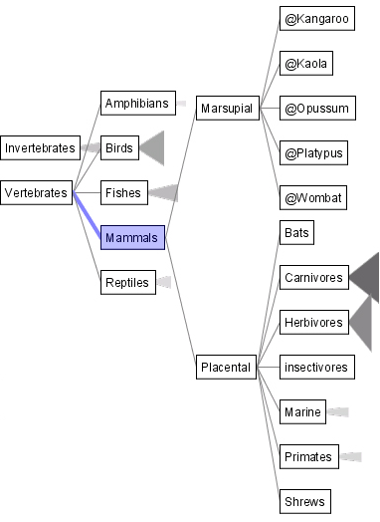
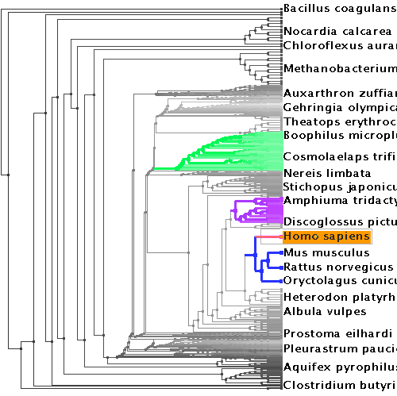
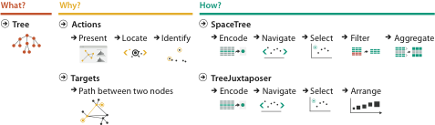

Why analyze?
SpaceTree
TreeJuxtaposer
imposes a structure on huge design space
scaffold to help you think systematically about choices
analyzing existing as stepping stone to designing new
[SpaceTree: Supporting Exploration in Large Node Link Tree, Design Evolution and Empirical Evaluation. Grosjean, Plaisant, and Bederson. Proc. InfoVis 2002, p 57–64.]
[TreeJuxtaposer: Scalable Tree Comparison Using Focus+Context With Guaranteed Visibility. ACM Trans. on Graphics (Proc. SIGGRAPH) 22:453– 462, 2003.]

Slide 10
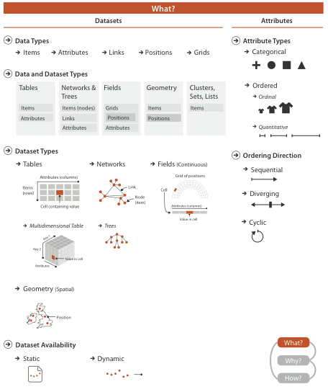
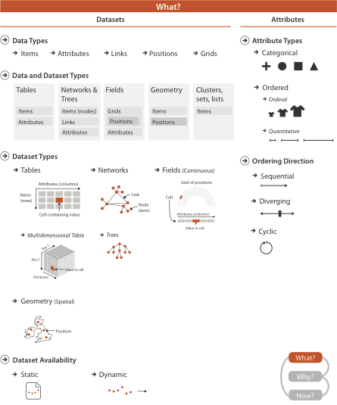

Slide 11
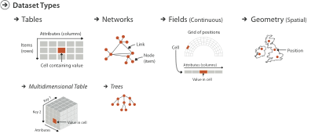
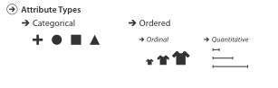
Types: Datasets and data
Spatial

Slide 12
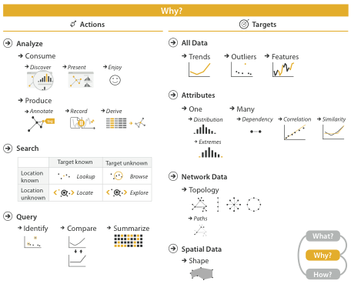
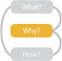
{action, target} pairs
discover distribution
compare trends
locate outliers
browse topology

Slide 13
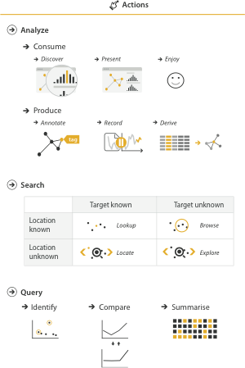
Actions 1: Analyze
consume
discover vs present
classic split
aka explore vs explain
enjoy
newcomer
aka casual, social
produce
annotate, record
derive
crucial design choice

Slide 14
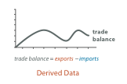
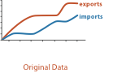
Derive
don’t just draw what you’re given!
decide what the right thing to show is
create it with a series of transformations from the original dataset
draw that
one of the four major strategies for handling complexity
14

Slide 15
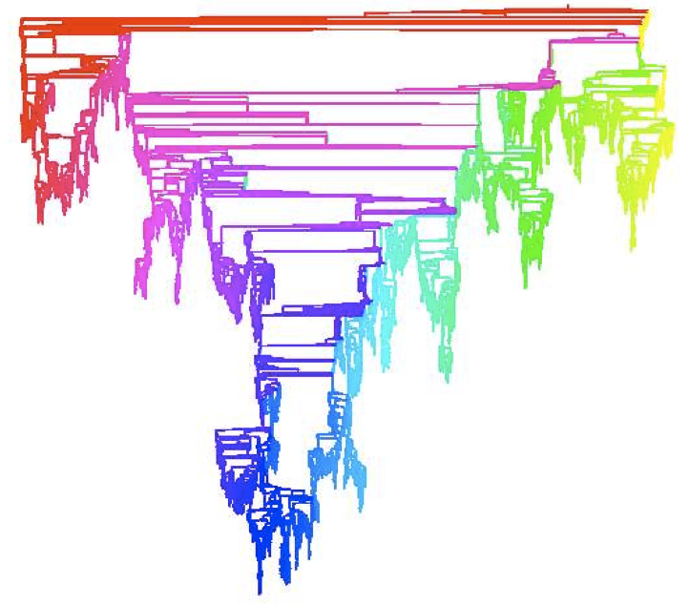
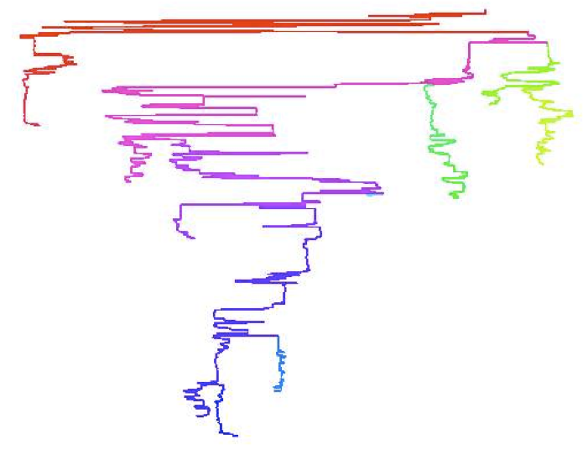
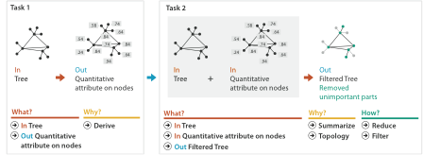
Analysis example: Derive one attribute
Strahler number
centrality metric for trees/networks
derived quantitative attribute
draw top 5K of 500K for good skeleton
[Using Strahler numbers for real time visual exploration of huge graphs. Auber. Proc. Intl. Conf. Computer Vision and Graphics, pp. 56–69, 2002.]

Slide 16
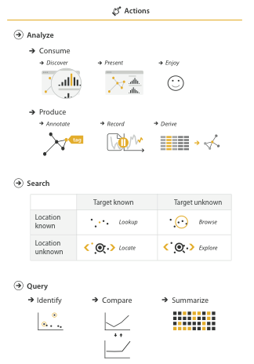
Actions II: Search
what does user know?
target, location

Slide 17
Actions III: Query
what does user know?
target, location
how much of the data matters?
one, some, all
analyze, search, query
independent choices for each

Slide 18
Targets

Slide 19
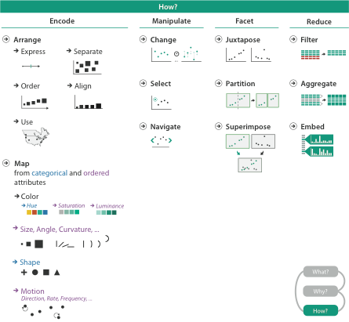
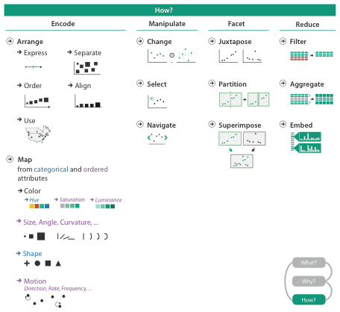
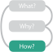

Slide 20
How to encode: Arrange space, map channels

Slide 21

Encoding visually
analyze idiom structure
21
Notes:
How did we decide to use those particular visual channels? How many more visual channels are there? What kinds of information and how much information can each channel encode? Are some channels better than others? Can all of the channels be used independently or do they interfere with each other?

Slide 22
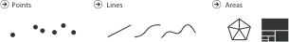
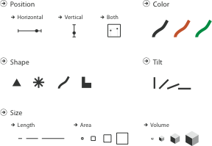
Definitions: Marks and channels
marks
geometric primitives
channels
control appearance of marks

Slide 23
Encoding visually with marks and channels
analyze idiom structure
as combination of marks and channels
1: vertical position
2: vertical position
horizontal position
3: vertical position
horizontal position
color hue
4: vertical position
horizontal position
color hue
size (area)
mark: line
mark: point
mark: point
mark: point
23

Slide 24
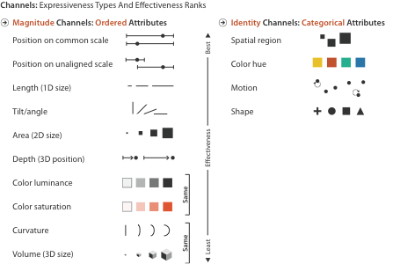
Channels: Expressiveness types and effectiveness rankings

Slide 25
Channels: Matching Types
expressiveness principle
match channel and data characteristics

Slide 26
Channels: Rankings
expressiveness principle
match channel and data characteristics
effectiveness principle
encode most important attributes with highest ranked channels

Slide 27


Slide 28
How to handle complexity: 3 more strategies
+ 1 previous
change view over time
facet across multiple views
reduce items/attributes within single view
derive new data to show within view

Slide 29

How to handle complexity: 3 more strategies
+ 1 previous
change over time
most obvious & flexible of the 4 strategies

Slide 30
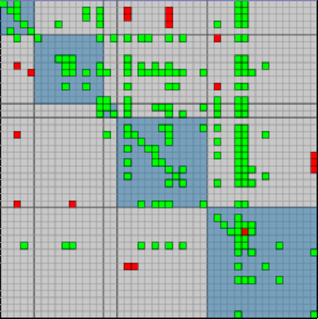
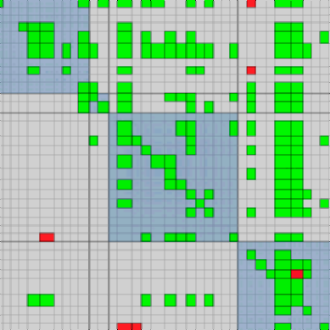
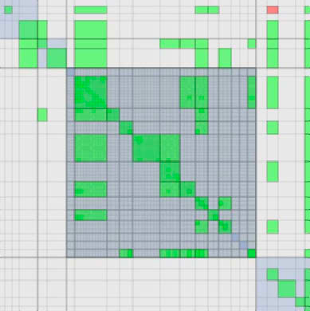
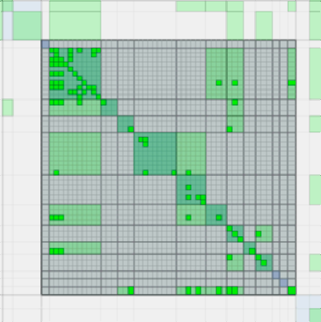
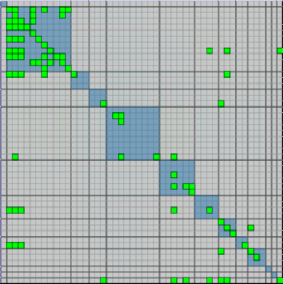
Idiom: Animated transitions
smooth transition from one state to another
alternative to jump cuts
support for item tracking when amount of change is limited
example: multilevel matrix views
scope of what is shown narrows down
middle block stretches to fill space, additional structure appears within
other blocks squish down to increasingly aggregated representations
[Using Multilevel Call Matrices in Large Software Projects. van Ham. Proc. IEEE Symp. Information Visualization (InfoVis), pp. 227–232, 2003.]
30

Slide 31

How to handle complexity: 3 more strategies
+ 1 previous
facet data across multiple views

Slide 32
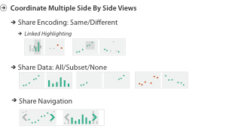
Facet

Slide 33
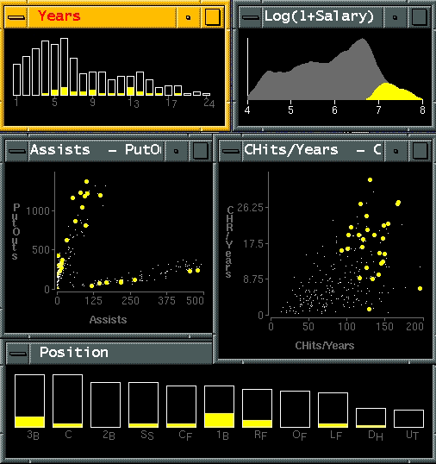
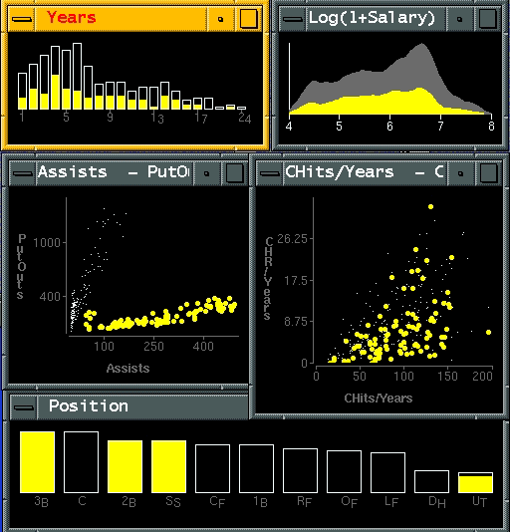
Idiom: Linked highlighting
System: EDV
see how regions contiguous in one view are distributed within another
powerful and pervasive interaction idiom
encoding: different
multiform
data: all shared
[Visual Exploration of Large Structured Datasets. Wills. Proc. New Techniques and Trends in Statistics (NTTS), pp. 237–246. IOS Press, 1995.]
Notes:
Linked highlighting between views shows how regions that are contiguous in one view are distributed within another. (a) Selecting the high salaries in the upper right window shows different distributions in the other views. (b) Selecting the bottom group in the Assists-Putouts window shows that the clump corresponds to specific positions played.

Slide 34
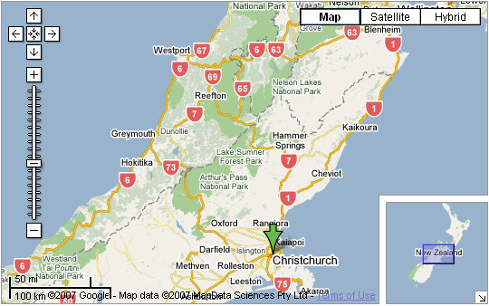
Idiom: bird’s-eye maps
System: Google Maps
encoding: same
data: subset shared
navigation: shared
bidirectional linking
differences
viewpoint
(size)
overview-detail
[A Review of Overview+Detail, Zooming, and Focus+Context Interfaces. Cockburn, Karlson, and Bederson. ACM Computing Surveys 41:1 (2008), 1–31.]

Slide 35

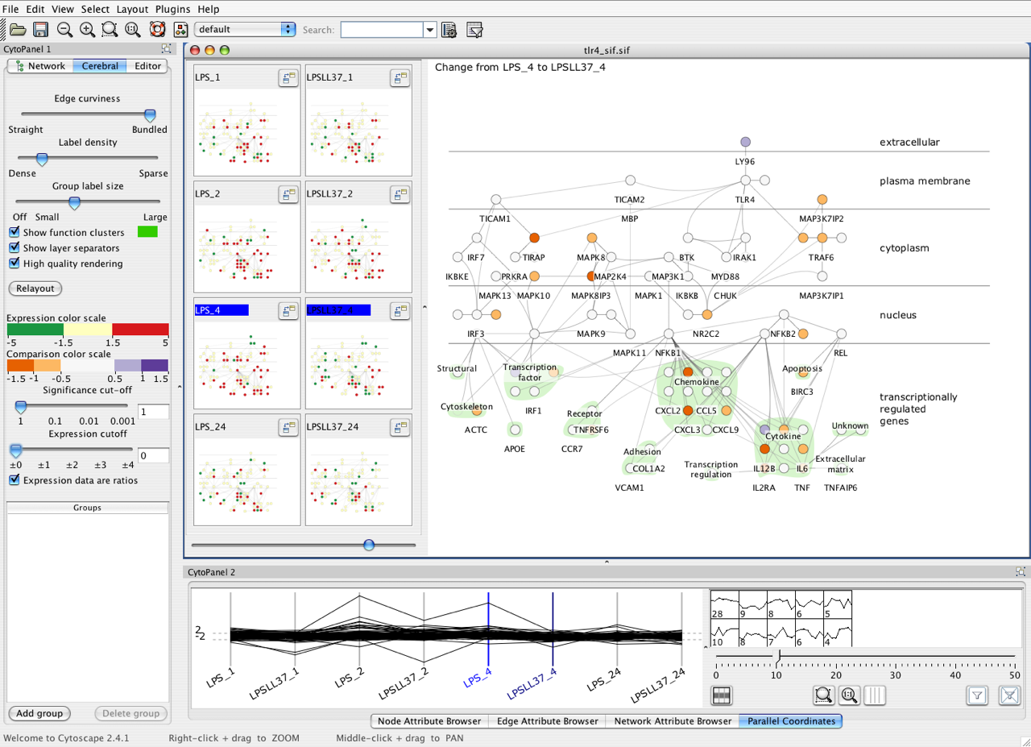



Idiom: Small multiples
System: Cerebral
encoding: same
data: none shared
different attributes for node colors
(same network layout)
navigation: shared
[Cerebral: Visualizing Multiple Experimental Conditions on a Graph with Biological Context. Barsky, Munzner, Gardy, and Kincaid. IEEE Trans. Visualization and Computer Graphics (Proc. InfoVis 2008) 14:6 (2008), 1253–1260.]

Slide 36
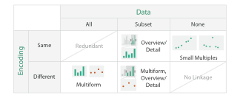
Coordinate views: Design choice interaction
why juxtapose views?
benefits: eyes vs memory
lower cognitive load to move eyes between 2 views than remembering previous state with single changing view
costs: display area, 2 views side by side each have only half the area of one view

Slide 37
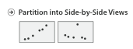
Partition into views
how to divide data between views
encodes association between items using spatial proximity
major implications for what patterns are visible
split according to attributes
design choices
how many splits
all the way down: one mark per region?
stop earlier, for more complex structure within region?
order in which attribs used to split
how many views
Notes:
Partioning and grouping are inverse terms; the term partitioning is natural when considering starting from the top and gradually refining; the term grouping is more natural when considering a bottom-up process of gradually consolidating. Conditioning is a synonym for partitioning that is used heavily in the statistics literature.

Slide 38
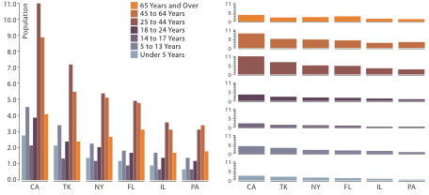
Partitioning: List alignment
single bar chart with grouped bars
split by state into regions
complex glyph within each region showing all ages
compare: easy within state, hard across ages
small-multiple bar charts
split by age into regions
one chart per region
compare: easy within age, harder across states
http:/bl.ocks.org/mbostock/3887051 http:/bl.ocks.org/mbostock/4679202

Slide 39
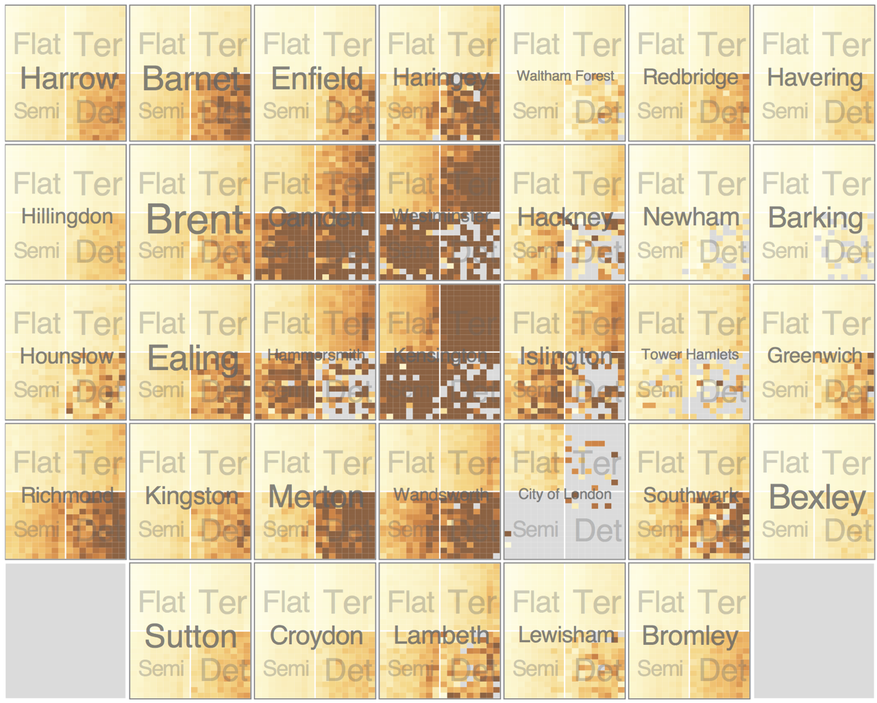
Partitioning: Recursive subdivision
System: HIVE
split by neighborhood
then by type
then time
years as rows
months as columns
color by price
neighborhood patterns
where it’s expensive
where you pay much more for detached type
[Configuring Hierarchical Layouts to Address Research Questions. Slingsby, Dykes, and Wood. IEEE Transactions on Visualization and Computer Graphics (Proc. InfoVis 2009) 15:6 (2009), 977–984.]

Slide 40
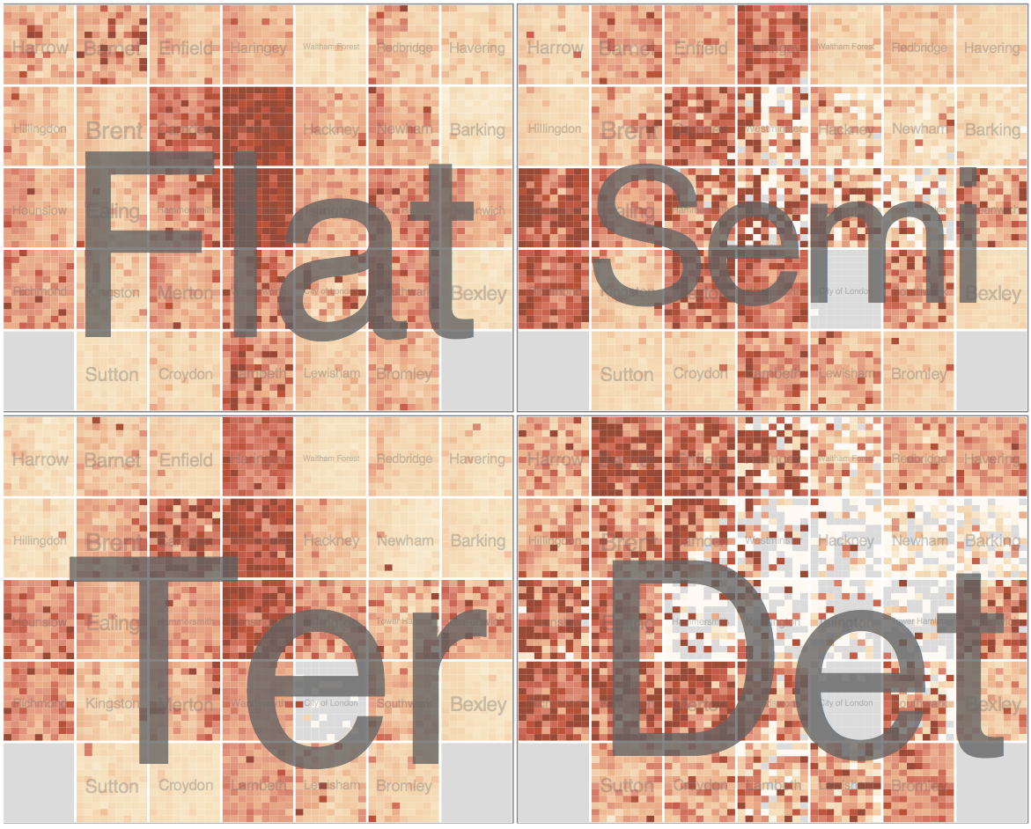
Partitioning: Recursive subdivision
System: HIVE
switch order of splits
type then neighborhood
switch color
by price variation
type patterns
within specific type, which neighborhoods inconsistent
[Configuring Hierarchical Layouts to Address Research Questions. Slingsby, Dykes, and Wood. IEEE Transactions on Visualization and Computer Graphics (Proc. InfoVis 2009) 15:6 (2009), 977–984.]

Slide 41
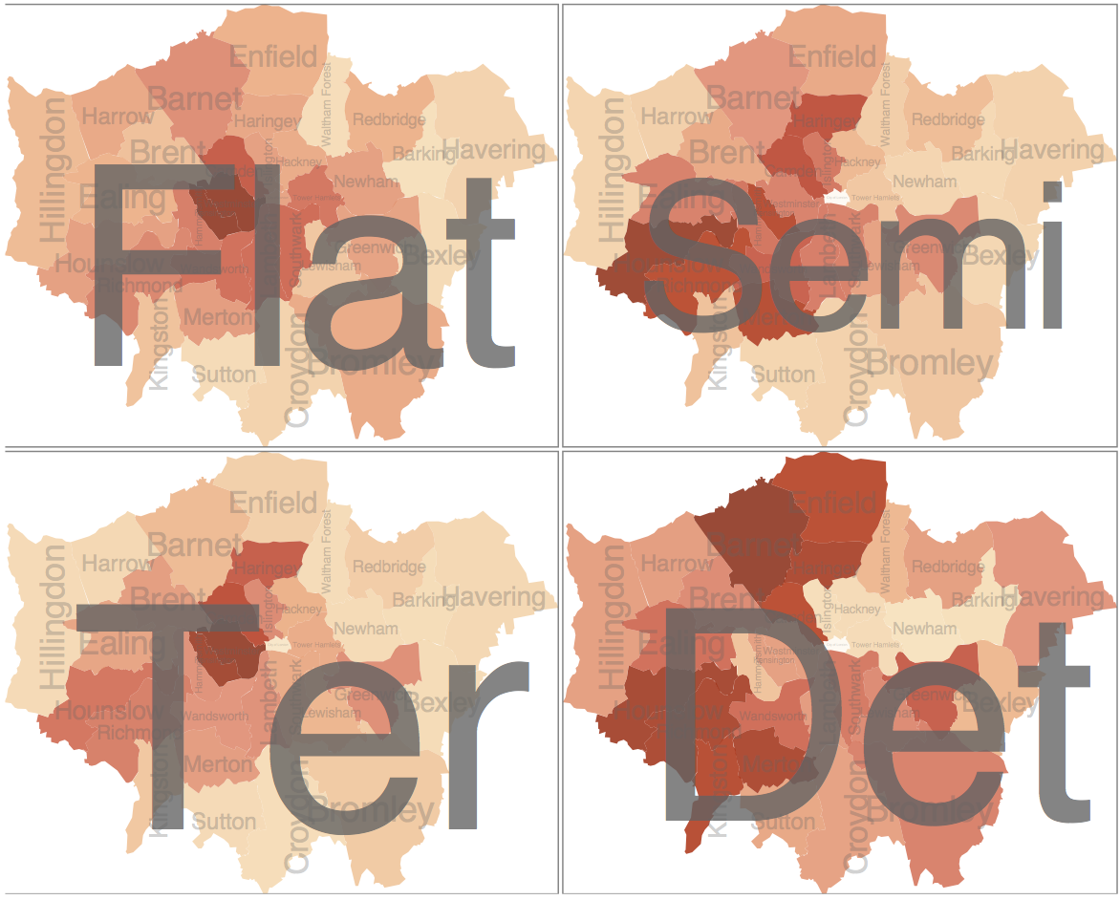
Partitioning: Recursive subdivision
System: HIVE
different encoding for second-level regions
choropleth maps
[Configuring Hierarchical Layouts to Address Research Questions. Slingsby, Dykes, and Wood. IEEE Transactions on Visualization and Computer Graphics (Proc. InfoVis 2009) 15:6 (2009), 977–984.]

Slide 42

How to handle complexity: 3 more strategies
+ 1 previous
reduce what is shown within single view

Slide 43
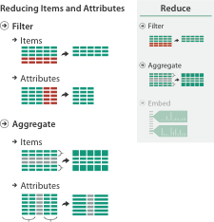

Reduce items and attributes
reduce/increase: inverses
filter
pro: straightforward and intuitive
to understand and compute
con: out of sight, out of mind
aggregation
pro: inform about whole set
con: difficult to avoid losing signal
not mutually exclusive
combine filter, aggregate
combine reduce, facet, change, derive

Slide 44
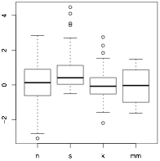
Idiom: boxplot
static item aggregation
task: find distribution
data: table
derived data
5 quant attribs
median: central line
lower and upper quartile: boxes
lower upper fences: whiskers
values beyond which items are outliers
outliers beyond fence cutoffs explicitly shown
[40 years of boxplots. Wickham and Stryjewski. 2012. had.co.nz]
44

Slide 45
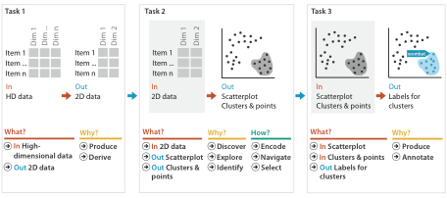
Idiom: Dimensionality reduction for documents
attribute aggregation
derive low-dimensional target space from high-dimensional measured space

Slide 46
domain
abstraction
idiom
algorithm

